Slide 1
Unit 2 (Contd.)
Lecture 3

Slide 2
4. Alphanumeric codes
Alphanumeric character set is a set of elements that includes the 10 decimal digits, 26 letters of the alphabet and special characters such as $, %, + etc.
It is necessary to formulate a binary code for this set to handle different data types.
If only capital letters are included, we need a binary code of at least six bits, and if both uppercase letters and lowercase letters are included, we need a binary code of at least seven bits.

Slide 3
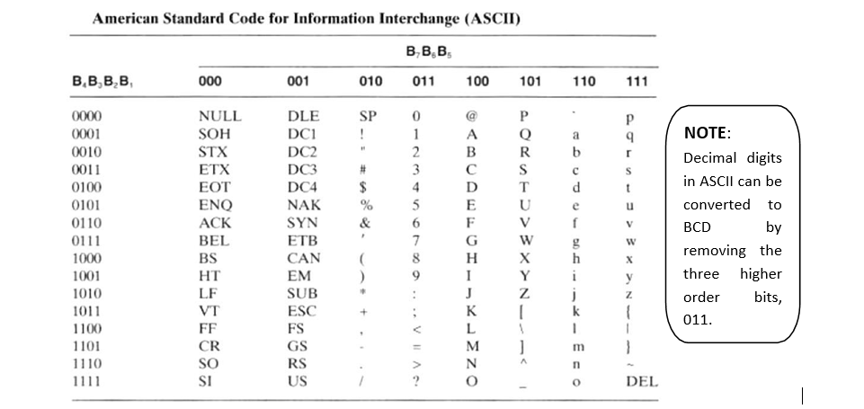
ASCII character code
The standard binary code for the alphanumeric characters is called ASCII (American Standard Code for Information Interchange). It uses seven bits to code 128 characters as shown in the table below. The seven bits of the code are designated by B1 through B7 with B7 being the most significant bit.

Slide 4
EBCDIC character code
EBCDIC (Extended Binary Coded Decimal Interchange Code) is another alphanumeric code used in IBM equipment. It uses eight bits for each character.
EBCDIC has the same character symbols as ASCII, but the bit assignment for characters is different. As the name implies, the binary code for the letters and numerals is an extension of the binary-coded decimal (BCD) code.
This means that the last four bits of the code range from 0000 though 1001 as in BCD.

Slide 5
Excess -3 Code
This is another form BCD Code, on which each Decimal Digit is coded into 4-bit Binary code.
The code for each Decimal Digit obtained by adding 3 to natural BCD code of the digit.
It is not-weighted code
This code is self – complementing code, which means 1’s complement of the coded number yields 9’s complement of number itself
For Example,

Slide 6
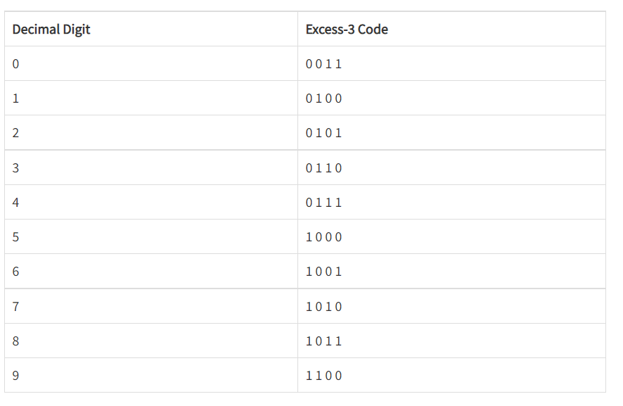

Slide 7
Positive & Negative Logic :
Positive logic is defined as a high voltage level representing a logic 1 and a low voltage level representing a logic 0.
Negative logic is the reverse, i.e., a low voltage level represents a logic 1 and a high voltage level represents a logic 0.

